Slide 1
A Reinforcement Learning AI for Atari Phoenix Game
Presented by: Bo (Roy) Zhang
April 24, 2020

Slide 2
Overview
Introduction
Design
Implementation
Results
Evaluation
Challenges
Future Work

Slide 3
Introduction - Reinforcement Learning Game AIs
First Atari Game AI, 2013
Dota 2: OpenAI Five, 2016 - 2019
Honor of Kings: Tencent JueWu, 2017 - 2020
StarCraft II: DeepMind AlphaStar, 2019

Slide 4
Introduction - Problem Description
Phoenix Level 4
Atari Phoenix Game:
Similar to Space Invaders
5 Levels
Boss
OpenAI Gym:
Raw pixel or RAM data as input
Support Atari 2600 games
Open source interface

Slide 5
Introduction - Motivation
Previous research
This project
Universal AI
Raw pixel input
High Score
Single Game AI
RAM data input
Pass all levels

Slide 6
Design - Architecture
Environment
Memory
Model
Policy
Agent

Slide 7
Design - Feature Selection & Pre-processing
Name | Related RAM Variable | Name | Related RAM Variable
If player is alive | #15 | Player’s X | #94
If player missile exists | #89 | Player missile’s X | #89 and #93
Player missile’s Y | #89 and #48 | If player armor is active | #49
Armor Cooldown | #70 | Step | #13
If Enemy[1 - 8] is alive | Level 1 - 2: #27 - 30 #34 - 37 Level 3 - 4: #27 - 33 Level 5: N/A | Enemy[1 - 8]’s X | Level 1 - 2: #27 - 30 #34 - 37 #99 - 106 Level 3 - 4: #27 - 33 #99 - 105 Level 5: N/A
Enemy[1 - 8]’s Y | Level 1 - 2: #27 - 30 #34 - 37 #41 - 44 Level 3 - 4: #27 - 33 #41 - 47 Level 5: N/A | Enemy[1 - 8]’s X speed | Level 1 - 2: #27 - 30 #34 - 37 #99 - 106 Level 3 - 4: #27 - 33 #99 - 105 Level 5: N/A
Enemy[1 - 8]’s Y speed | Level 1 - 2: #27 - 30 #34 - 37 #65 - 66 Level 3 - 4: #27 - 33 #64 Level 5: N/A | If enemy missile[1 - 4] exists | #62
Enemy missile[1 - 4]’s X | #62 and #85 - 88 | Enemy missile[1 - 4]’s Y | #62 and #58 - 61
Note: Ram variables #1, 3 - 7, 12, 27 - 46, 51, 90 - 91, 95, 98, 110, 122, 126 - 127 are also used in level 5.

Slide 8
Design - Reinforcement Learning Algorithm Selection
Algorithm | Model | Action Space | State Space
Dynamic Programming | Model-Based | Discrete | Discrete
Monte Carlo | Model-Free | Discrete | Discrete
Q-Learning | Model-Free | Discrete | Discrete
Sarsa | Model-Free | Discrete | Discrete
Deep Q Network | Model-Free | Discrete | Continuous
Double DQN | Model-Free | Discrete | Continuous
Dueling DQN | Model-Free | Discrete | Continuous
Policy Gradient | Model-Free | Continuous | Continuous
Actor Critic | Model-Free | Continuous | Continuous
DDPG | Model-Free | Continuous | Continuous
Value | Action
0 | No action
1 | Fire
2 | Move right
3 | Move left
4 | Armor
5 | Move right + Fire
6 | Move left + Fire
7 | Armor + Fire

Slide 9
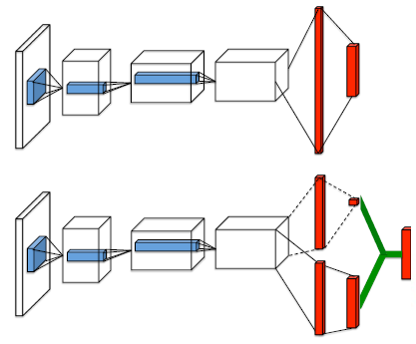

Design - Reinforcement Learning Algorithm Selection
s: current state
s’: state after action a is taken
r: current reward
γ: discount factor
Q(s, a) = V(s) + A(s, a)
A popular single stream Q-network (top) and the dueling Q-network (bottom)

Slide 10
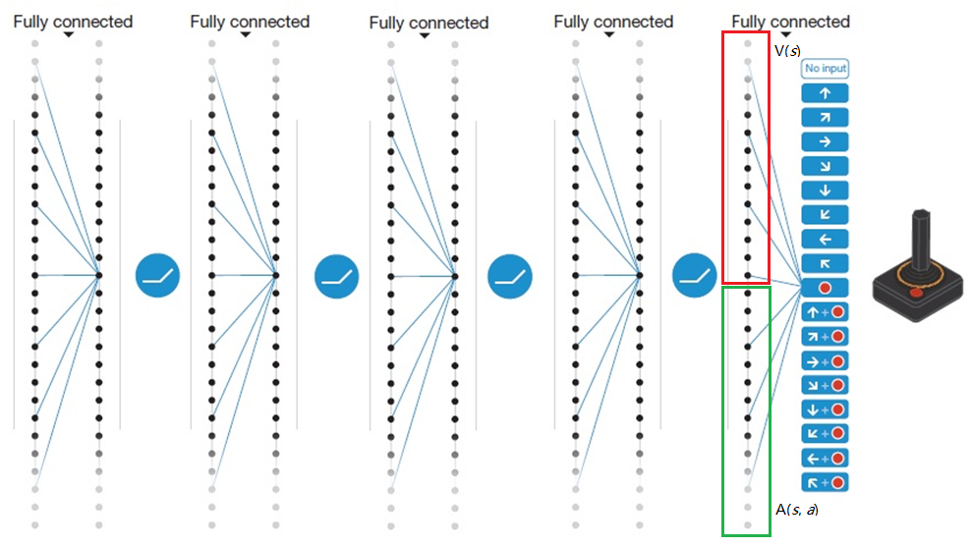
Design - Neural Network Structure Design

Slide 11
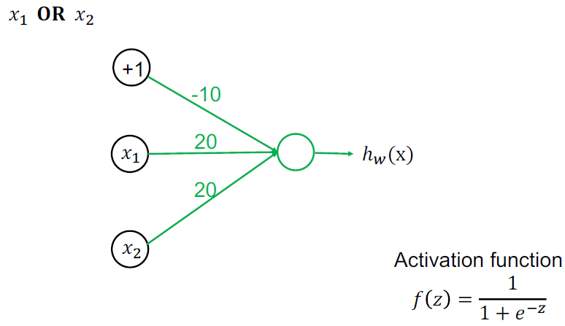
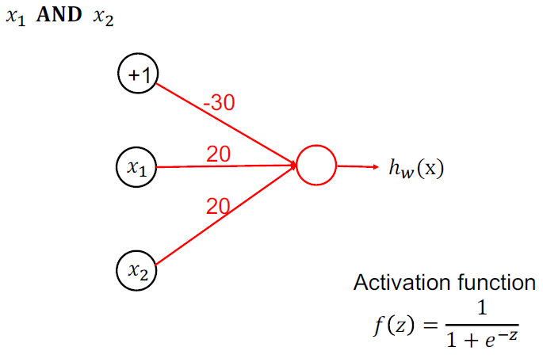
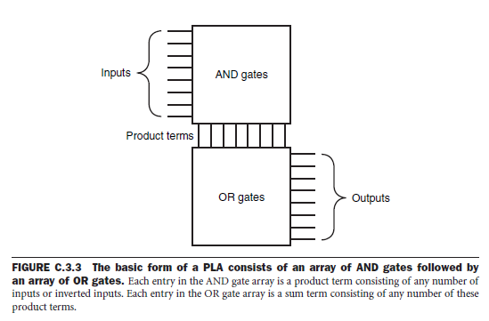
Design - Neural Network Structure Design

Slide 12
Design - Reward Function
Enemy Destroy
1 point
Life Lost
-2 point
Mothership Hit
0.2 - 1 point

Slide 13
Design - Policy
Training Policy
Validation (Testing) Policy
Boltzmann Q
Greedy Q

Slide 14
Implementation - Tools
Keras-rl
Agent
TensorFlow
Training and testing framework
Memory
Model
Policy
No Prioritized Experience Replay

Slide 15
Implementation - Hyper-parameters
Memory
Memory Size: 1,000,000
Window Length: 1
Policy
Tau: 1
Clip: [-500, 500]
Model
Agent
Optimizer: Adam optimizer
Learning Rate: 0.00025
Metrics: MAE
AMSGrad variant: False
β₁: 0.9
β₂: 0.999
Target Model Update Period: 10,000
γ: 0.99
Batch Size: 32
Warm up Steps: 50,000
Train Interval: 1
Memory Interval: 1
Δ Clip: 1
Dueling Type: Average

Slide 16
Implementation - Training Strategies
Scenario 1
Level 1
Level 2
Scenario 2
Level 3
Level 4
Scenario 3
Level 5
New episode starts from restore point as validation process
Transfer to training process after death or 100 unscored steps
Step into next scenario if pass current one as validation process, and set it as restore point
Start new episode if lose all lives or pass current scenario as training process
Armor activated
Exclude 2, 3, 4, 5, 6, 7
Armor cooldown
Exclude 4, 7
Already fired
Exclude 1, 5, 6, 7
A similar strategy is used in “On Catastrophic Interference in Atari 2600 Games” by Google

Slide 17
Results
130s / 10,000 steps (Pascal)
4,371,421 steps
Passed all 5 levels for 3 rounds
11 hours (Laptop)
Scenario |  | Steps | Total Steps
Round 1 | Level 1 - 2 | 118,022 | 118,022
 | Level 3 - 4 | 1,159,019 | 1,277,041
 | Level 5 | 206,908 | 1,483,949
Round 2 | Level 1 - 2 | 361,286 | 1,845,235
 | Level 3 - 4 | 494,273 | 2,339,508
 | Level 5 | 164,550 | 2,504,058
Round 3 | Level 1 – 2 | 123,356 | 2,627,414
 | Level 3 – 4 | 1,494,799 | 4,122,213
 | Level 5 | 249,208 | 4,371,421
250k steps
1,500k steps
final

Slide 18
Evaluation
410s / 10,000 steps (Pascal)
10M steps
Only passed 2 levels
5 days

Slide 19
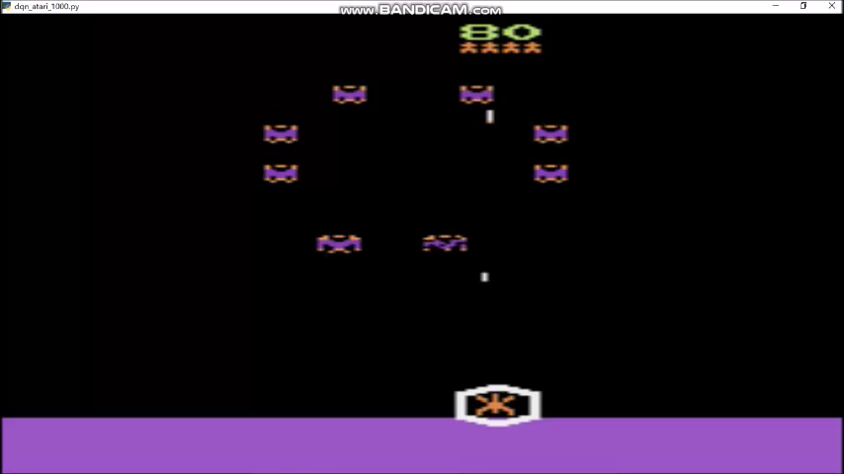

Slide 20
Challenges
Deterministic Environment
Different RAM data formats and value ranges
Unknown RAM variables
Round | Level 1 RAM #63 Value Range
1 | {0, 128}
2 | {108, 236}
3 | {41, 169}

Slide 21
Summary
Beat Keras-RL default AI
Performance
Efficiency
Pass 5 levels for 3 rounds
Can pass more rounds
Enough Training time
Overfitting

Slide 22
Future Work
Prioritized Experience Replay
Hierarchical Action
More Efficient
Action | No Fire | Fire
No action | 0 | 1
Move right | 2 | 5
Move left | 3 | 6
Armor | 4 | 7

Slide 23
References
Volodymyr Mnih, Koray Kavukcuoglu, David Silver, Alex Graves, Ioannis Antonoglou, Daan Wierstra, Martin Riedmiller. 2013. Playing atari with deep reinforcement learning. ArXiv preprint arXiv:1312.5602
Christopher Berner, Greg Brockman, Brooke Chan, Vicki Cheung, Przemysław Dębiak, Christy Dennison, David Farhi, Quirin Fischer, Shariq Hashme, Chris Hesse, et al. 2019. Dota 2 with large scale deep reinforcement learning. ArXiv preprint arXiv:1912.06680
Vinyals, O., Babuschkin, I., Czarnecki, W.M. et al. 2019. Grandmaster level in StarCraft II using multi-agent reinforcement learning. Nature 575, 350–354. https://doi.org/10.1038/s41586-019-1724-z
D. Ye, Z. Liu, M. Sun, B. Shi, P. Zhao, H. Wu, H. Yu, S. Yang, X. Wu, Q. Guo, et al. 2020. Mastering complex control in moba games with deep reinforcement learning. In AAAI.
Phoenix (video game). url: https://en.wikipedia.org/wiki/Phoenix_(video_game) (visited on 04/12/2020).
Brockman, G., Cheung, V., Pettersson, L., Schneider, J., Schulman, J., Tang, J., & Zaremba, W. 2016. OpenAI Gym. ArXiv, abs/1606.01540
Ziyu Wang, Nando de Freitas, and Marc Lanctot. 2016. Dueling Network Architectures for Deep Reinforcement Learning. In ICLR.
Mnih, V., Kavukcuoglu, K., Silver, D. et al. 2015. Human-level control through deep reinforcement learning. Nature 518, 529–533. https://doi.org/10.1038/nature14236
Sygnowski, Jakub & Michalewski, Henryk. 2017. Learning from the Memory of Atari 2600. 71-85. 10.1007/978-3-319-57969-6_6
Plappert M. 2016. Keras-rl. GitHub Repository.
Abadi, M., Agarwal, A., Barham, P., Brevdo, E., Chen, Z., Citro, C., Corrado, G.S., Davis, A., Dean, J., Devin, M., Ghemawat, S., Goodfellow, I., Harp, A., Irving, G., Isard, M., Jia, Y., Jozefowicz, R., Kaiser, L., Kudlur, M., Levenberg, J., Mane, D., Monga, R., Moore, S., Murray, D., Olah, C., Schuster, M., Shlens, J., Steiner, B., Sutskever, I., Talwar, K., Tucker, P., Vanhoucke, V., Vasudevan, V., Viegas, F., Vinyals, O., Warden, P., Wattenberg, M., Wicke, M., Yu, Y., Zheng, X. 2016. TensorFlow: Large-scale machine learning on heterogeneous distributed systems

Slide 24
Thank you

Slide 25
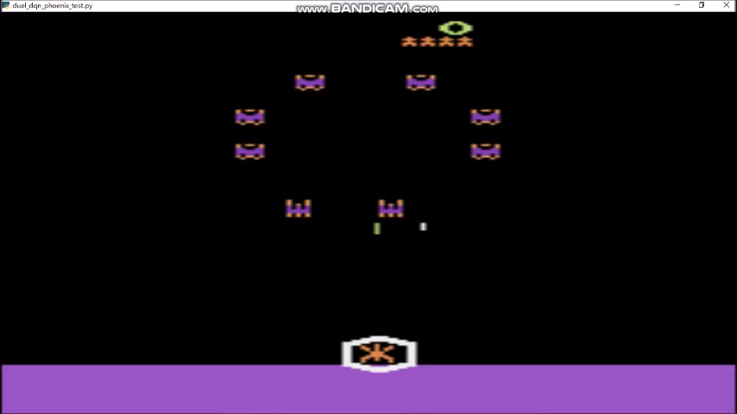

Slide 26


Slide 27
